Slide 1
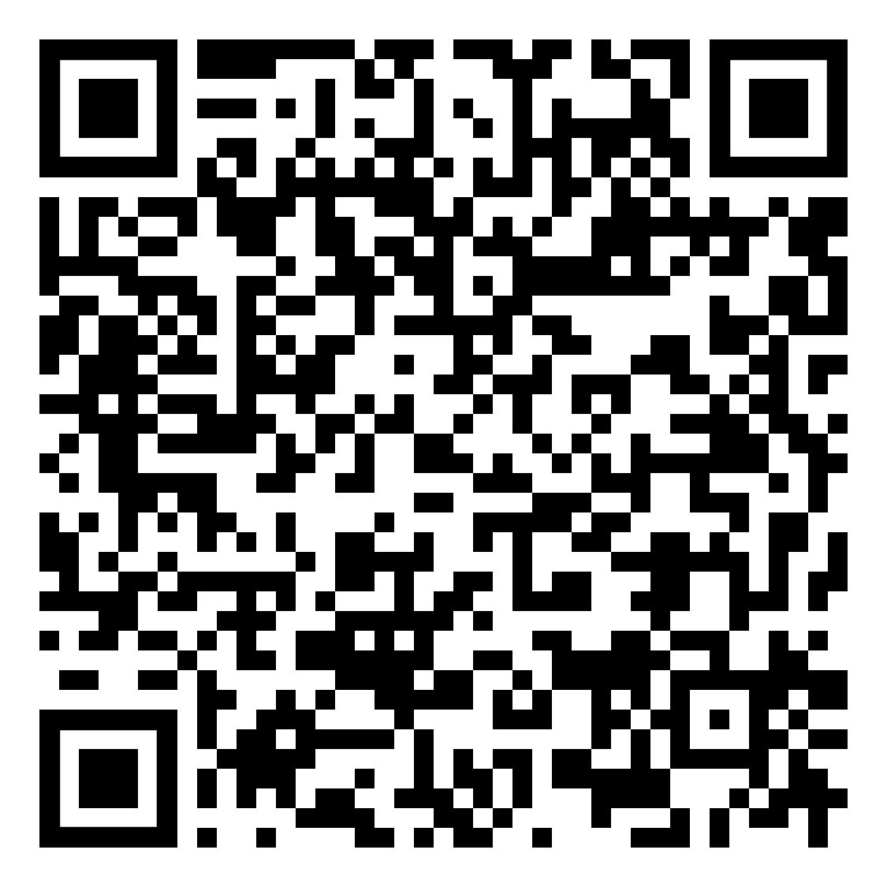
INVITATION TO AN IEEE XPLORE EVENT
Date:
February 26th, 2020
Wednesday
Time:
11:00 – 13:00
Place:
Technical University of Crete
Amphitheater, Science Building, Level 1
Trainer:
Eszter Lukács
IEEE Client Services Manager
e.lukacs@ieee.org
How to publish at IEEE?
What is new around the IEEE
Insider tips for using IEEE Xplore
How to find a good conference or a journal title for my ideas?
Basic structure of a scientific article
Overview of the peer-review process
Possibilities to publish open access articles at the IEEE
Open discussion about questions and problems regarding writing and submitting papers
Freely available resources for authors
Win small prices with your active participation!
Please register for the event!
Contact: Maria Ntaountaki, maria@library.tuc.gr
Eszter Lukacs, e.lukacs@ieee.org

